Slide 1
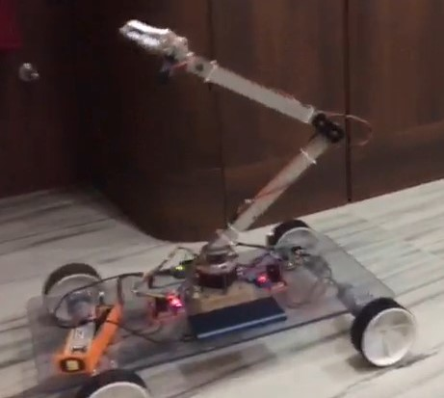
ROBOTIC ARM USING ARDUINO
Presented By:-
SUMANA KUNDU (13)
SRIJA DAS GUPTA (22)
SOHINI JANA (28)
SHREYASHI GANAI (35)
SHIVANSHI (37)

Slide 2
CONTENTS
Introduction
Parts Used
Arduino Programming
Android Application
Working Procedure
Conclusion
Future Scope
References

Slide 3
INTRODUCTION
Automation systems minimise errors and produce quality
products. Most used components of automation systems are
robots.
Robotic systems include knowledge of Mechatronics,
Electrical, Mechanical and Computer Engineering.
Arm under consideration consists of 5 servo motors and can
move in 4 axis directions.
Arduino microcontrollers are programmed using C language.
Arm is controlled by Android phone or tablet.

Slide 4
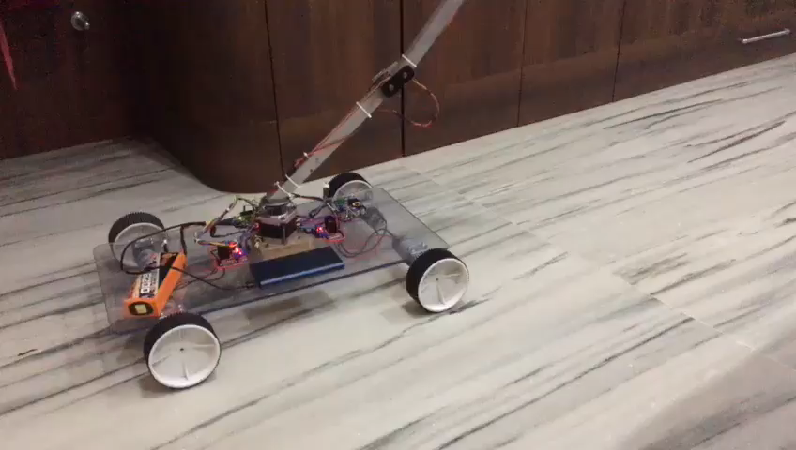

Slide 5
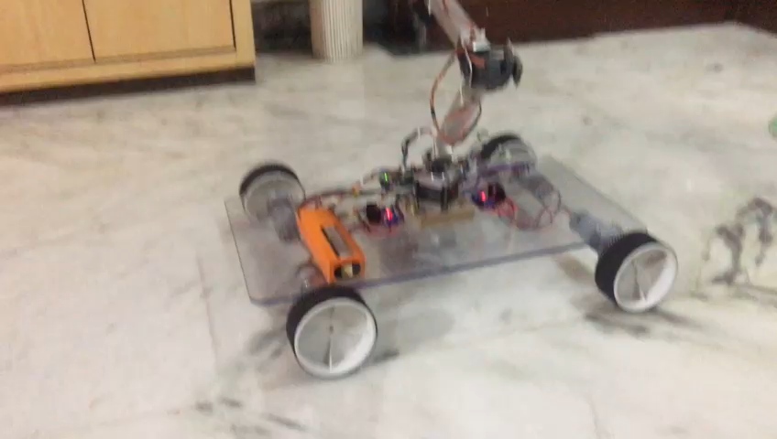

Slide 6
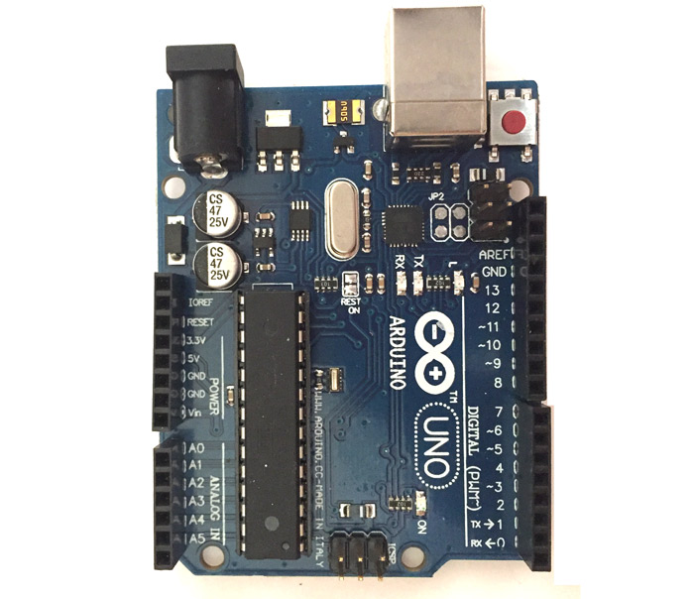
ARDUINO UNO MICROCONTROLLER
It is an open source.
It can be programmed using C and C++ language.
13KB of memory is used to store the number of instructions in the form of code.
Arduino Uno comes with USB interface
There are 14 I/O digital and 6 analog pins.

Slide 7
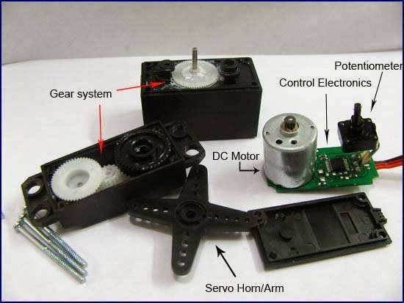
SERVO MOTORS
Operates steadily even at very small or very large speeds.
Highly sensitive.
Used in conjunction with electronic or programmable circuits.
Servos have three cables (red for power, black for ground, yellow for control.
Controlled by PWM signal at 10-20 ms and at 0.5-1.5 ms.

Slide 8
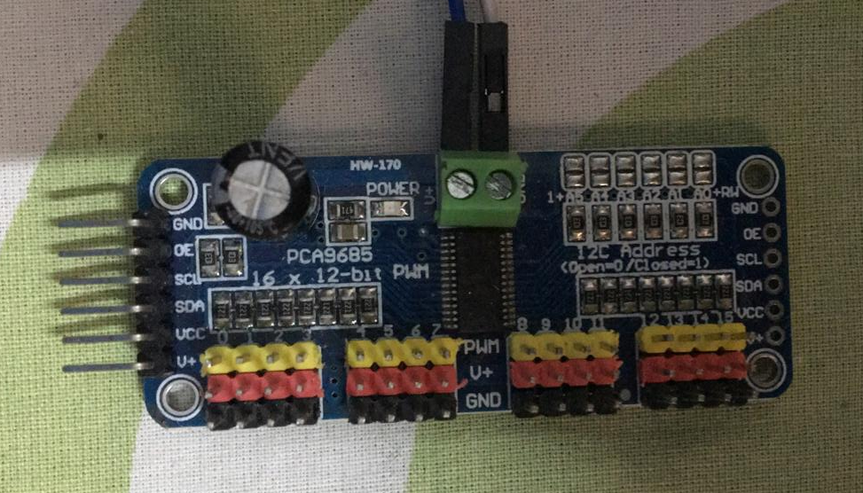
SERVO CONTROLLER
Heart of a Servo motor.
Control the motion of a servo and help it to hold a specific position.
Automatic device use feedback mechanism to ensure the output is achieving the desired effect.
We have used 16 channel Servo Controller (12C bus)

Slide 9
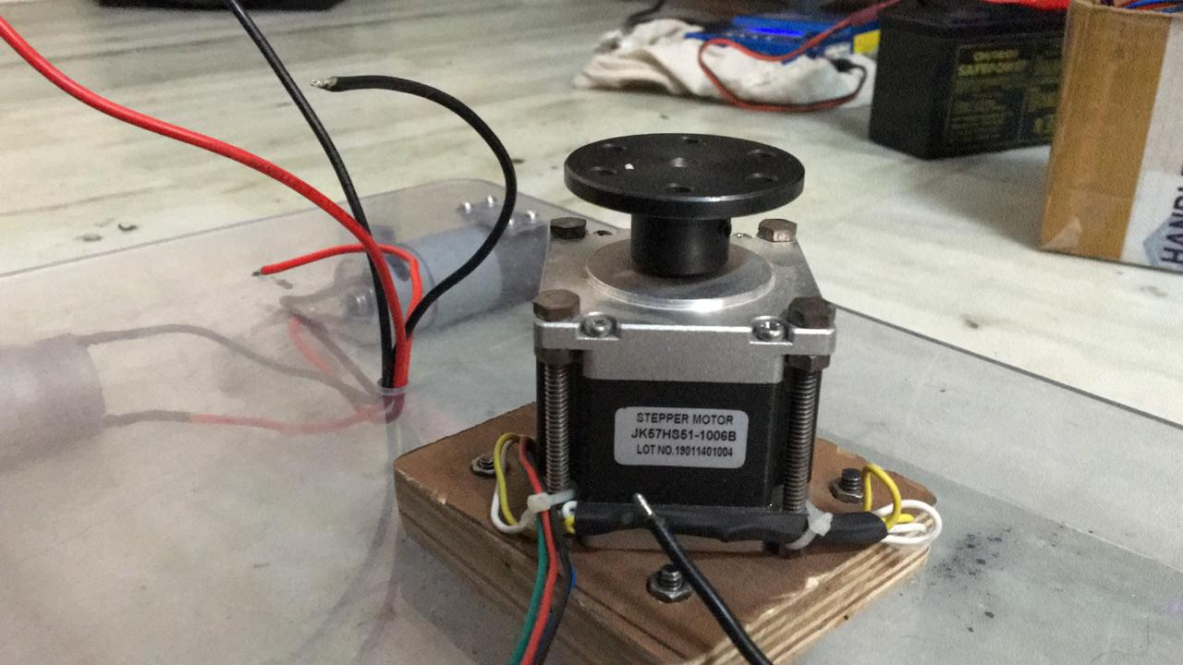
STEPPER MOTOR
Use for precise positioning.
Rotation control by exciting coils in correct order and polarity.
Bi-directional rotation.
Uses the theory of operation for magnets.
Operates at 6.6 V.

Slide 10
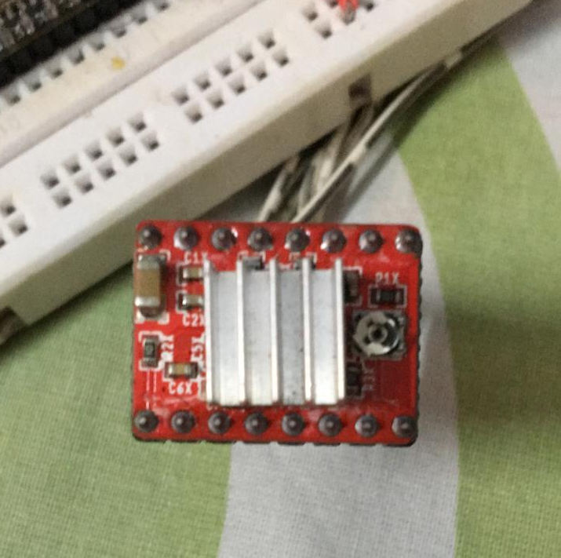
STEPPER MOTOR DRIVER
It is the driver circuit that controls how the stepper motor operates.
Work by sending current through various phases in pulses to the stepper motor.

Slide 11
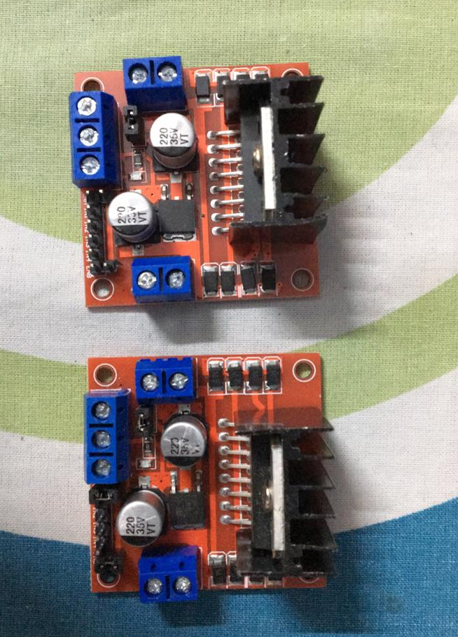
H-BRIDGE MOTOR CONTROLLER
It switches the polarity of voltage.
Allows speed and direction control of two DC motors at the same time.
Model: L298N

Slide 12
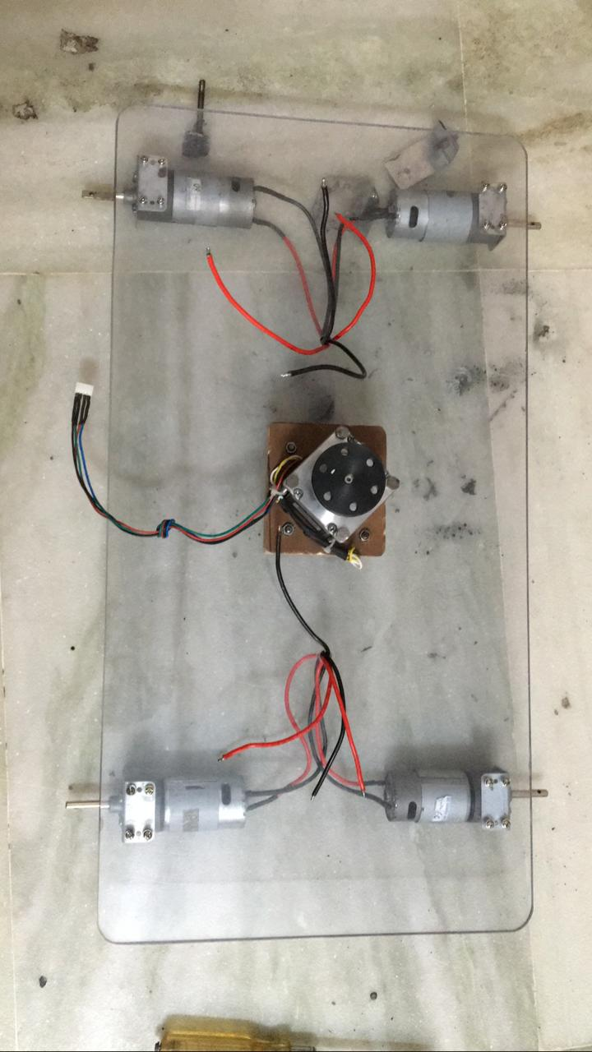
GEARED MOTOR
It is a electric motor coupled with gear train.
Can use AC or DC power.
The addition of a gear box is intended to limit the speed of the motor's shaft.
60 RPM motor.
Use 12 V power supply.

Slide 13
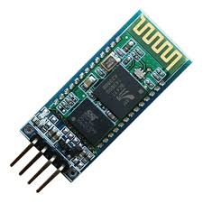
BLUETOOTH MODULE HC-06
The Bluetooth module HC-06 has 4 pins, 2 for power and 2 to establish connection.
VCC power supply. Typically hooked up to 5V pin of the Arduino.
GND ground. Typically hooked up to GND pin of the Arduino
RX reception pin. Typically hooked up to transmission pin (TX) of the Arduino
TX transmission pin. Typically hooked up to reception pin (RX) of the Arduino
To handle the module HC-06 we use the library SoftwareSerial.h which allows to define Serial port on the Arduino board. Functions to be known are:

Slide 14
After your module is paired, you can modify the following code to obtain the desired functionality. In this example, we expect the other device (such as an app on smartphone) to send the command ON or OFF to activate a function on the Arduino.
SoftwareSerial hc06(Rx,Tx) to define the pins of the serial port
hc06.begin() to define the baudrate (value should be the same as your module)
hc06.available() to test if data are available in the buffer of the module
hc06.read() to read data one byte at a time
hc06.print() to send a string in ASCII form
hc06.write() to send data one byte at a time

Slide 15
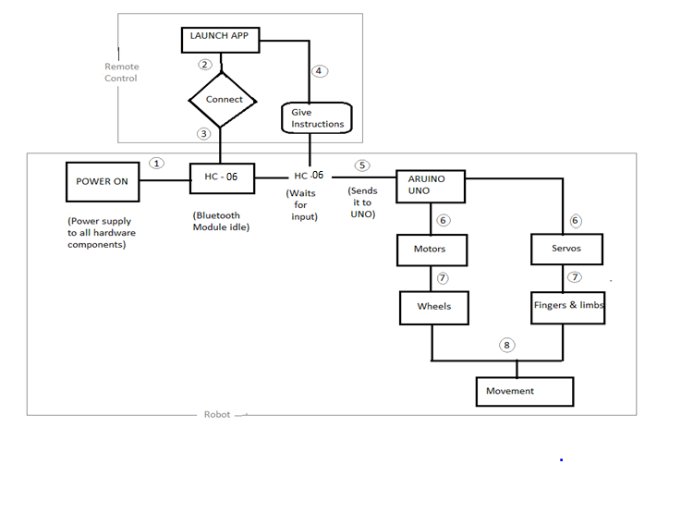
ARM MECHANICS

Slide 16
BREIFINGS ABOUT DESIGNING THE MODEL
Determination of the mechanical materials required for the
production of the project.
Determination of microcontroller and software to be used in the
project.
Selection of servo motors that will run the robot arm in a proper way.
Implementation of robot arm assembly.
Testing the system to see if it works properly with the
microcontroller.

Slide 17
MECHANICAL PART MOUNTING
Robot arm moves by 4 axes and performs this movement with 5
mini Servo Motors.
Robot arm is made of a stationary lower body and movable
upper body.
One servo motor in the stationary lower part which is axis 1. It
provides rotation of the robot arm to the right or left.
There are 2 servo motors in the moving upper body part namely
axis 2 and 3. These are to move the robot arm up and down.

Slide 18
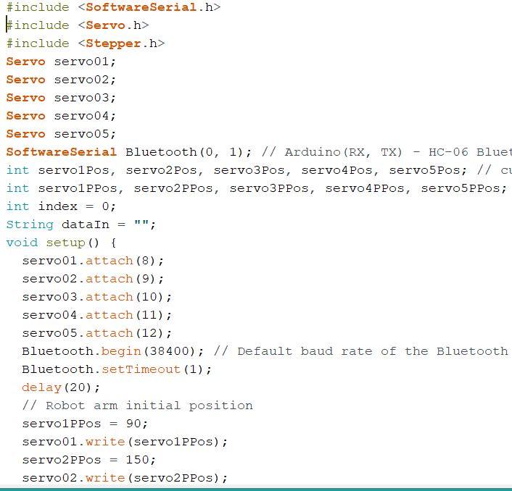
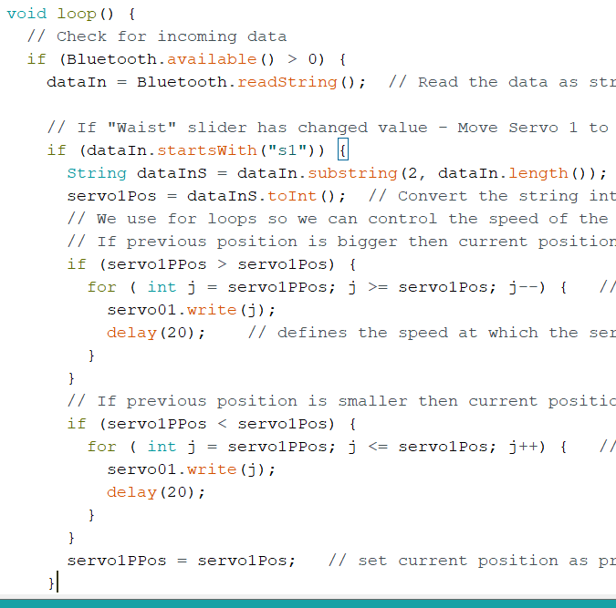
ARDUINO PROGRAMMING

Slide 19
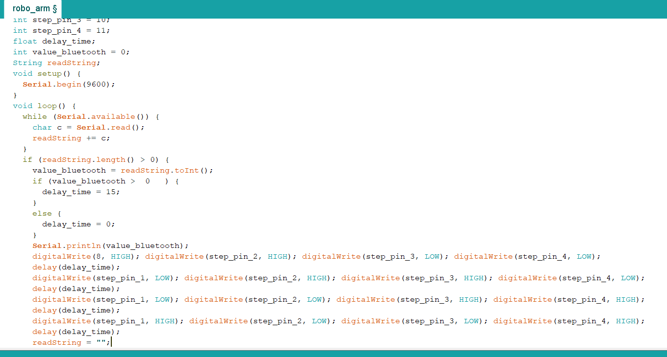

Slide 20
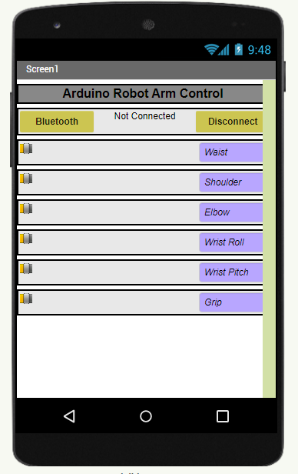
ANDROID APPLICATION
Android app used in project is made using App Inventor.
App Inventor is a free web application developed by Google.
Components of the application developed are Buttons, Pictures, Text Fields.
Acceleration and Bluetooth sensor can be added to the device along with GPS.

Slide 21
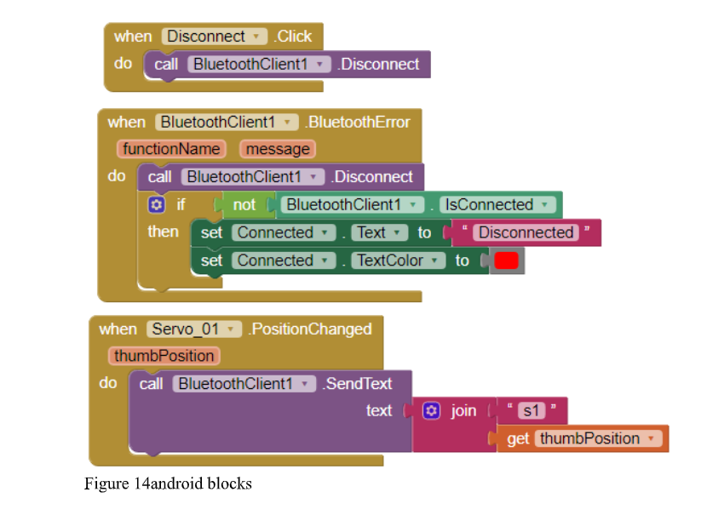

Slide 22
EXPERIMENTAL STUDIES
Experimental studies involve the projected method, robot arm
Control system, and programmimg.
PROJECTED METHOD
Robot presented in the project will be able to move in 4 directions.
Arm can hold and swing objects with the help of holder.
Arduino uno is used to provide optimal control of robot arm.
Servos provide steady motion.
Microcontroller is used as it is open source.

Slide 23
ROBOT ARM CONTROL
The connection box is made to distribute the 5V voltage from
the supply source to the servo motors.
The connection box is made to distribute the 5V voltage from
the supply source to the servo motors.
Software has been implemented with the appropriate Arduino
microcontroller.
Control of the robot arm is achieved by moving the axes of the
android application.

Slide 24
FUTURE SCOPE
Medical Science - Brain Computer Interface (BCI) is an
immerging field of research, can be used to acquire signals from
the human brain and control the arm.
Clothing Retail Industry - Help the users to feel the texture of the
clothes on the internet.
Mechanical Design- More efficient, reliable, improved power.
Shoulder, elbow & wrist movement allowing circular & angular
rotations.
Universal Gripper - Capable of doing multiple tasks.
Intelligence - Capable of making decisions about the task it
performs.

Slide 25
CONCLUSION
With the usage of robots many tasks are made easier and the
resulting error level has been reduced to a minimum.
Pharmacy-based drug-giving robots and a projected robot arm have
been developed.
The purpose of the project is to provide control of 4 axes moving
robot arm design with a suitable microcontroller and Bluetooth
module with android application.
During the process of making and developing the project, a lot of theoretical knowledge has been transferred to the practice .

Slide 26
REFERENCES
WMHW Kadir, RE Samin, BSK Ibrahim. Internet controlled a robotic arm. Procedia Engineering. 2012.
MAK Yusoff, RE Samin, mobile robotic arm. Procedia Engineering. 2012.
AM Al-Busaidi, Development of an educational environment for online control of a biped robot using MATLAB and Arduino, (MECHATRONICS), 9th France-Japan.2012.
HS Juang, KY Lurrr. Design and control of a two-wheel self-balancing robot using the Arduino microcontroller board. Control and Automation (ICCA), 2013.
R Krishna, GS Bala, SS ASC, BBP Sarma. Design and implementation of a robotic arm based on haptic technology. Int. J. of Eng. Research. 2012.
Electric Electronic Technology-Step and Servo Motors, SVET, 2007.

Slide 27
THANK YOU

